Slide 1
Supporting Oxford County’s
Zero Waste Future
June 8, 2016

Slide 2
Transitioning Oxford!
Transition to Less Waste (TTLW) – Part of the international community ‘Transition Movement’
Moving local festivals towards zero waste since 2001
Sharing information on ways to reduce our environmental footprint
Promoting environmental sustainability, land stewardship, environmental justice, and community resilience
Engaging in community partnerships
Modeling green choices

Slide 3
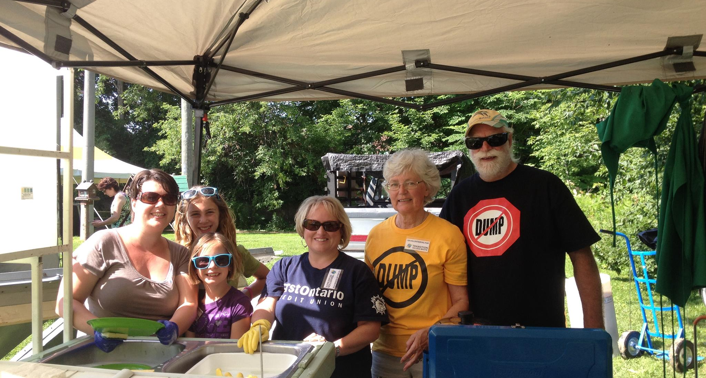
TTLW in the Community
Notes:
Working with our partners to increase community sustainability and resilience

Slide 4
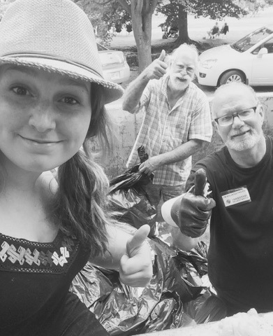
Notes:
Moving the Canterbury Folk Festival and other festivals towards zero waste

Slide 5
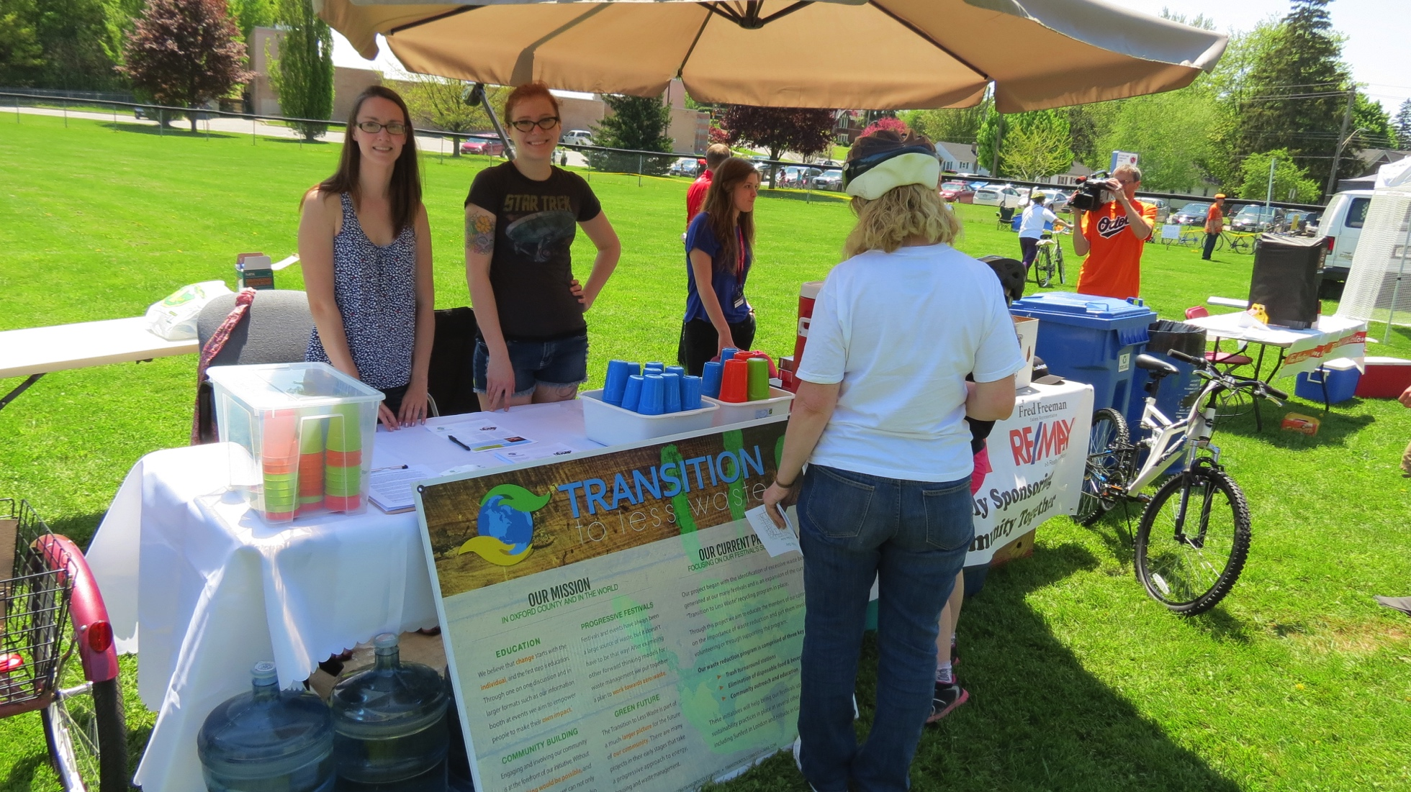
Notes:
Providing volunteer services to the community, in coordination with other groups and organizations

Slide 6
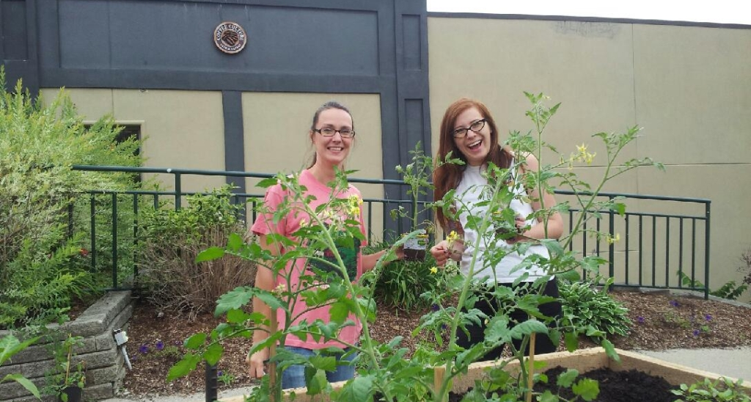
Notes:
Community Demonstration Garden

Slide 7

Notes:
Electric vehicles charged with home solar

Slide 8
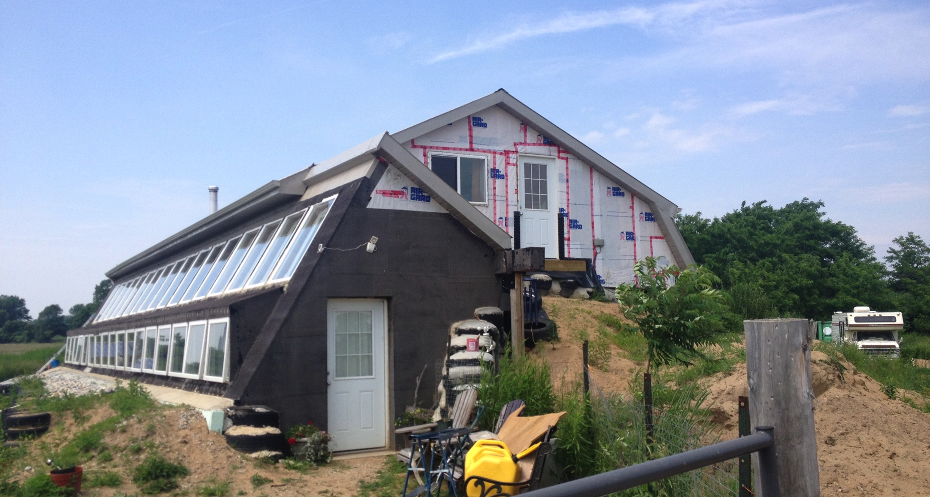
Notes:
Zero footprint housing

Slide 9
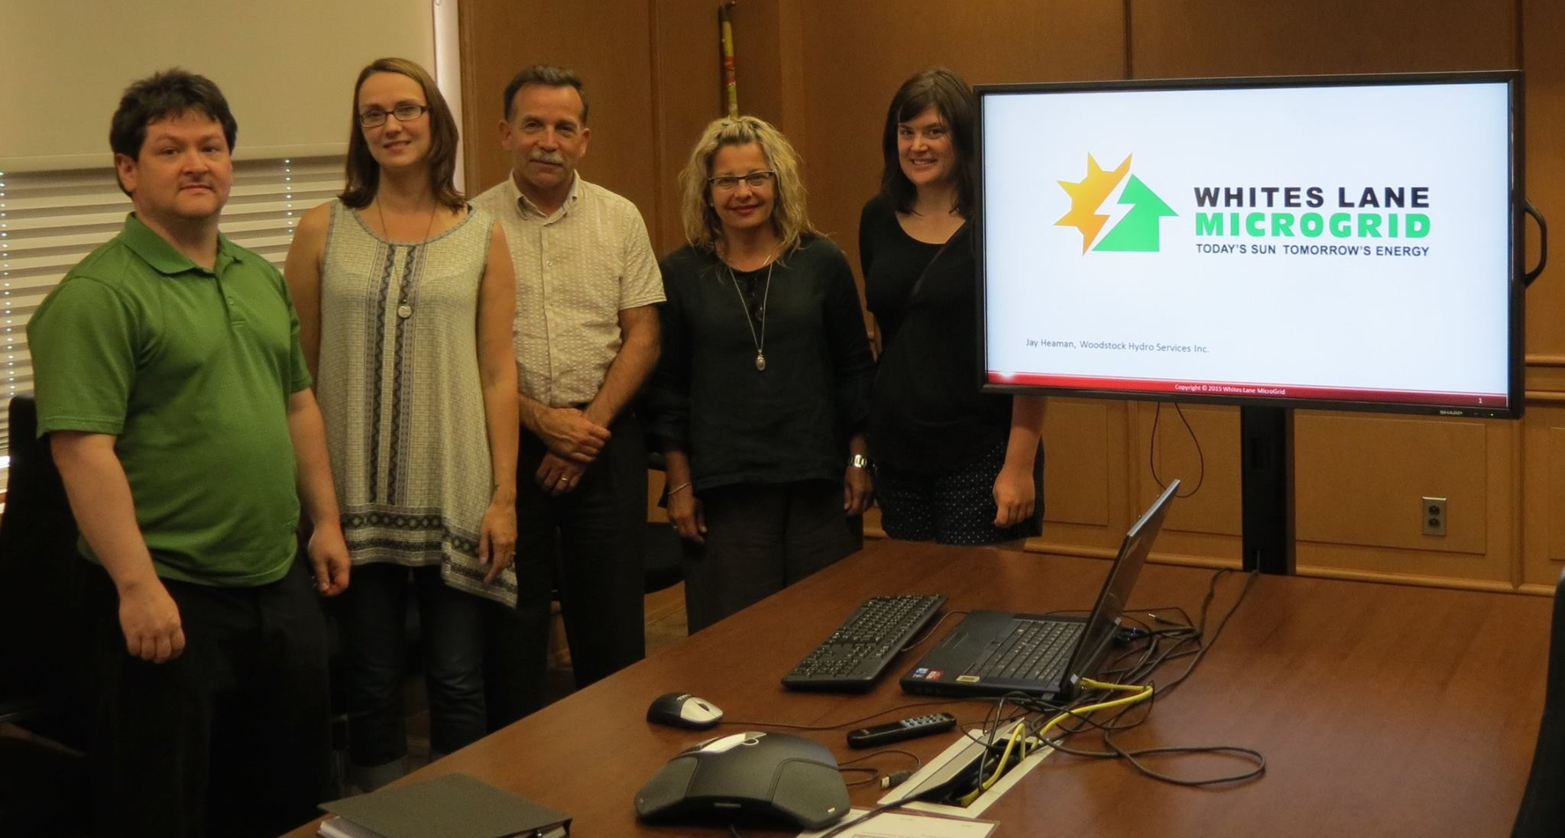
Leading a Job Creation Partnership Project

Slide 10
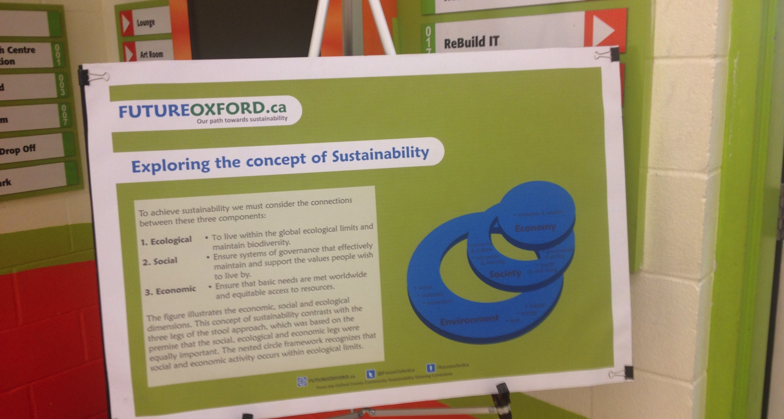
Future Oxford
Notes:
Encouraging our membership and partners to participate in Future Oxford’s community events and consultation

Slide 11
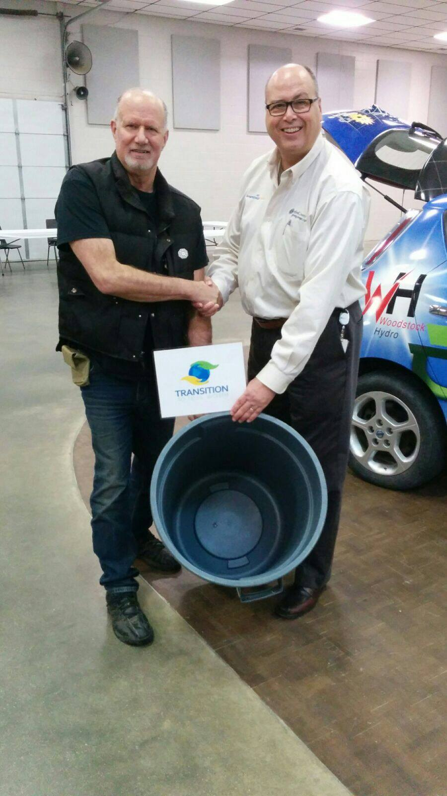
The Future Oxford Expo – A Zero Waste Event

Slide 12
Waste Free Ontario
Participated in MOECC consultation sessions
Submitted written comment report to MOECC
Continuing discussions with MOECC
TTLW supports a robust Waste Free Ontario Act, including producer responsibility

Slide 13
Zero Waste Oxford
Providing a community perspective
Sharing information
Researching innovative solutions
Advocating for a safe, clean future for Oxford’s citizens

Slide 14
Supporting OP Waste Policy Amendments
TTLW applauds Oxford County for comprehensive and inclusive consultation on policies that will impact public health and safety, and the environment
Oxford’s citizens have made their views clear: We will continue to model a move towards zero waste and advocate for other municipalities to employ our progressive solutions
Oxford’s proposed Official Plan amendments are reflective of Ontario’s goals of moving the province towards zero waste to disposal
Oxford is poised to lead the province in waste diversion

Slide 15
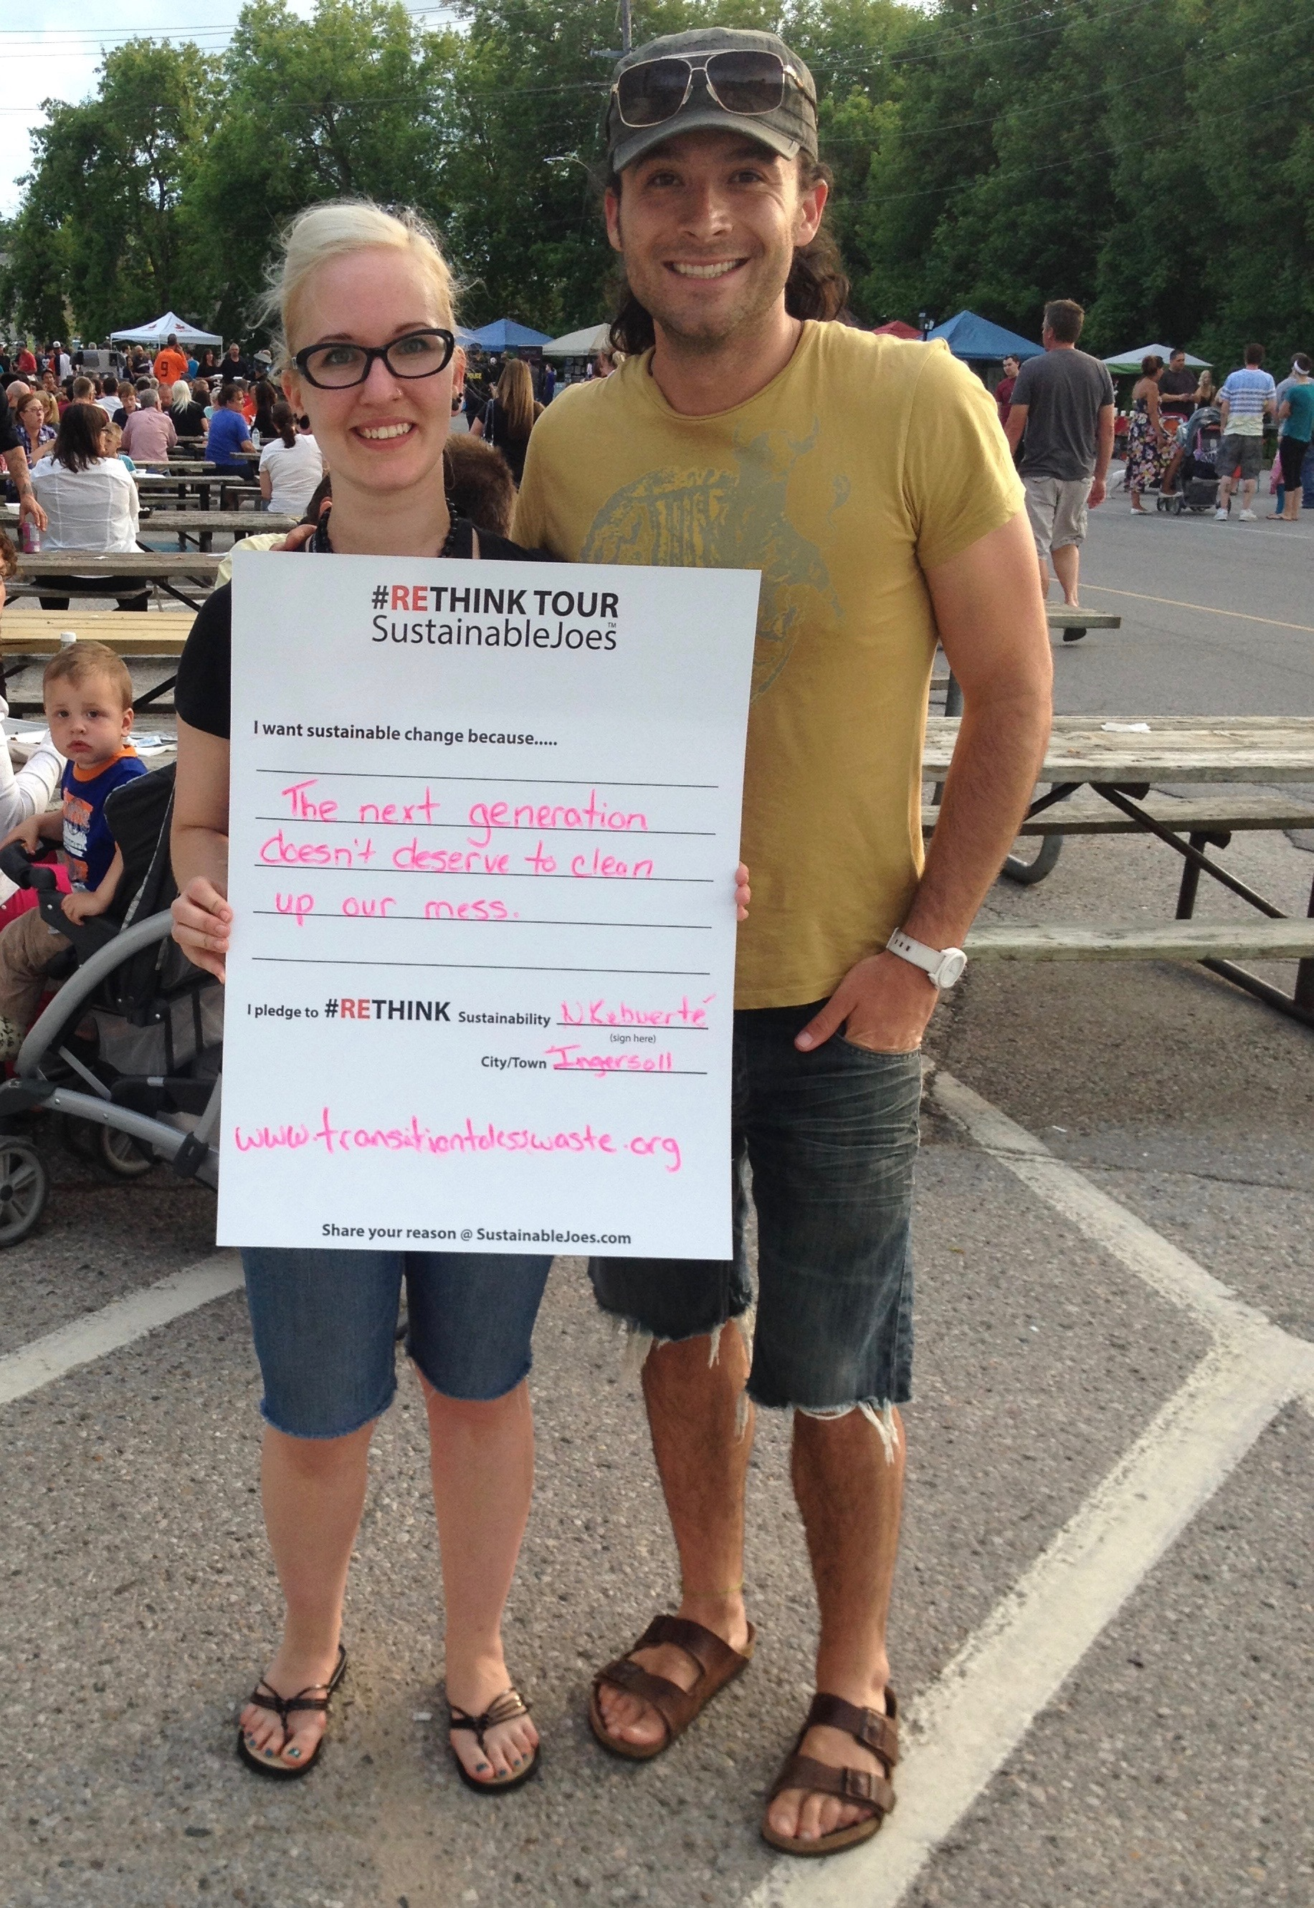
Looking Forward

Slide 16
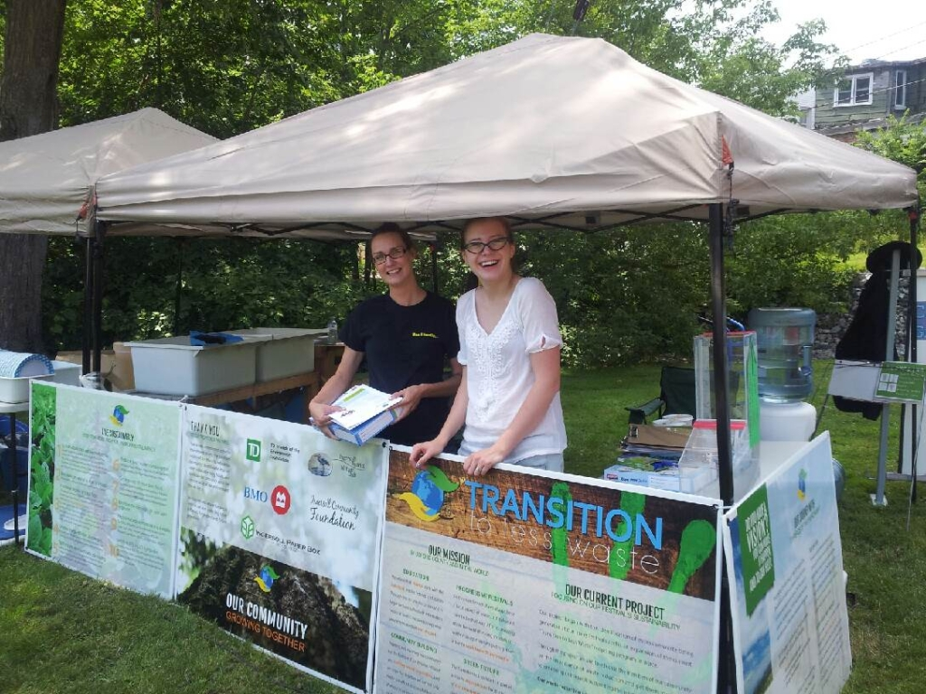
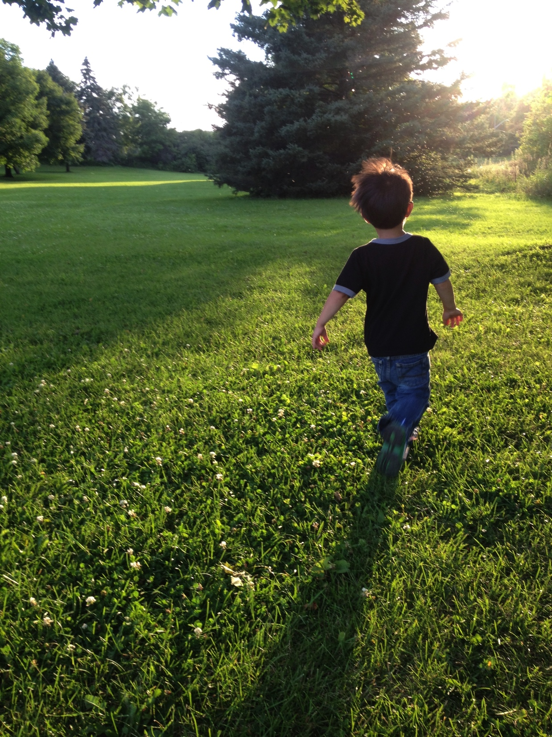
To Volunteer or Learn More
Facebook.com/TransitionToLessWaste
Twitter.com/TransitionTLW

